Slide 1

Suicide Rate Analysis
Aishwary Gawande
Nitish Singh
Zahra Booyavi
Notes:
The main goal is to implement a simple linear regression model in order to predict and draw conclusions about the 1st year of operations of this bike sharing service. (http://capitalbikeshare.com/system-data)

Slide 2
Purpose of Analysis:
GOAL
In the span of 29 years (i.e. 1985- 2014) analyze the overall suicide trend whether it has been increasing or decreasing and determines which factor caused (or impacted) the trend to change, compared to previous years.
SPECIFIC QUESTIONS
1. Which age-group of people or gender mostly have been the victim of suicide, the most considering their demographical and biographical information.
2. How the suicide rate evolves during the long period of time?
Notes:
Why should anyone care?
Bike sharing systems are a new generation of traditional bike rentals where the whole process from membership, rental and return back has become automatic. Forecasting the futurstic demand has been cruical to many businesses. With acurate forecasts the cost can be kept down by optimizing the business operations. A forecast provides this look as a foundation upon which to plan.

Slide 3
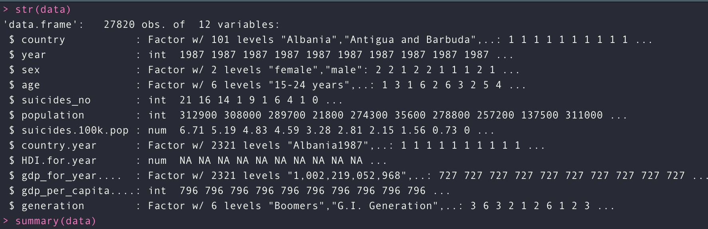
About the data
Dataset has 12 variables and 27820 rows.
Dependent Variables : Total No of Suicide
Independent Variables : population, age-group, sex, country, country, year, generation population, HDI.for.year, gdp_for_year, gdp_per_capita
Notes:
Hour dataset has the hourly count of bikes. While the day data set has the same information by hourwise. The bikes users can be a casual user or a registered user.

Slide 4
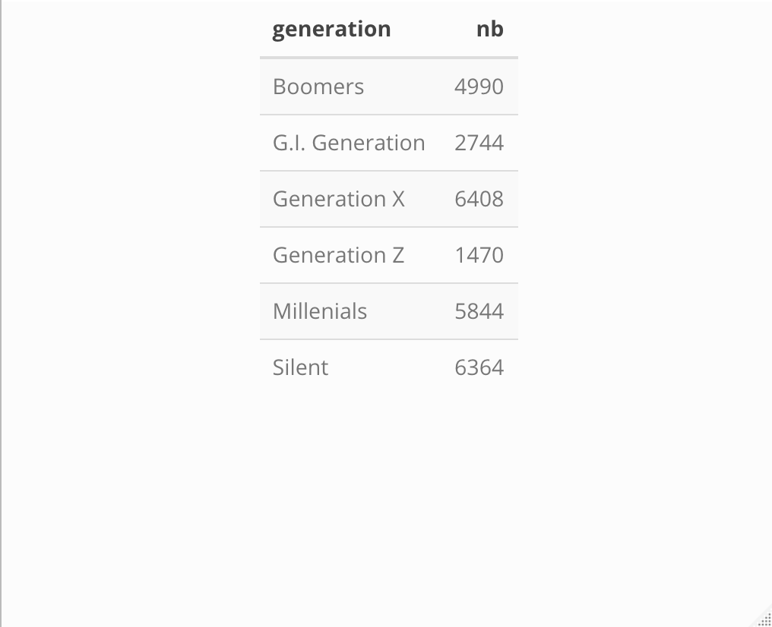
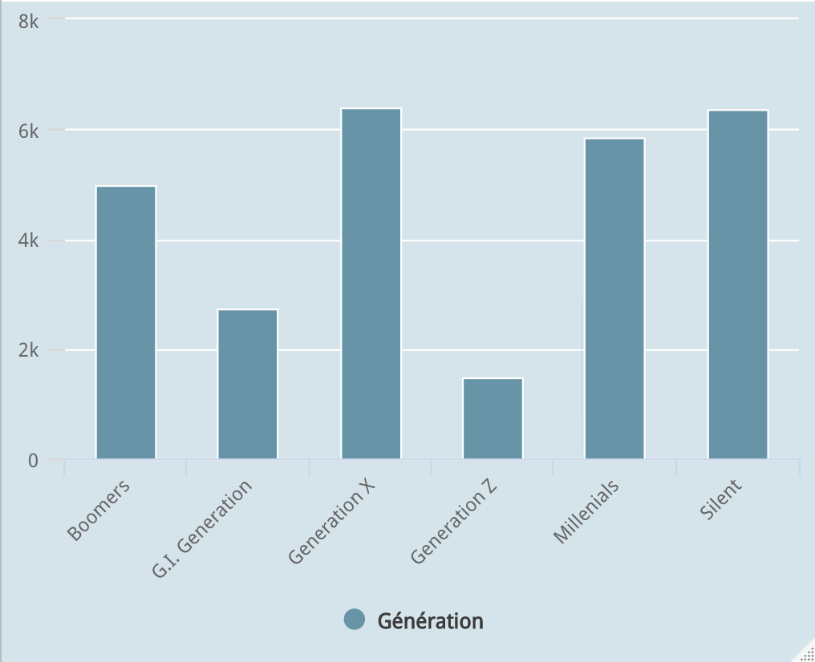
Data exploration
Qualitative Variable frequencies:
1.No of occurences of each generation in the dataset.
2. X generation and silent are the most popular.
Generation Z is the smallest group.
hcbar(x = data$generation, name = "Génération") %>%
hc_add_theme(hc_theme_economist())

Slide 5
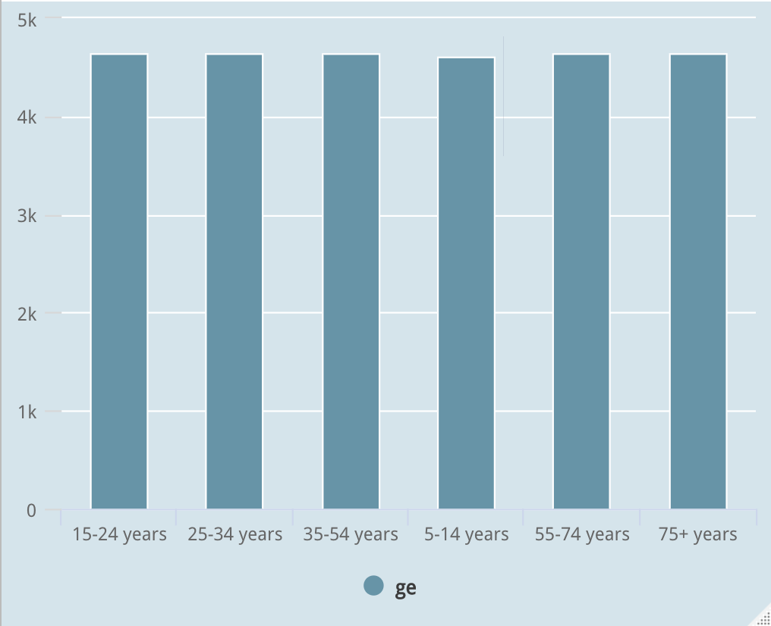
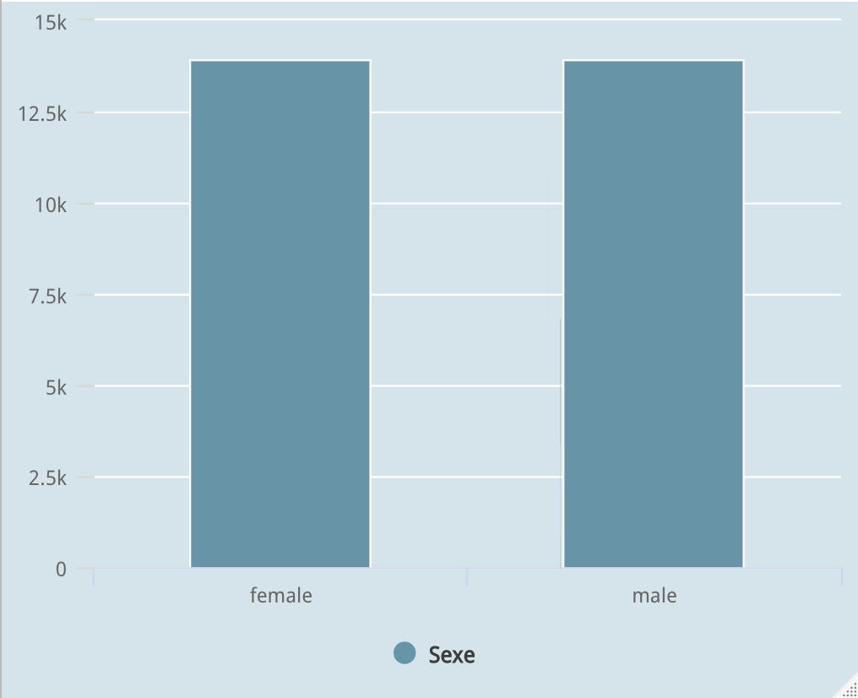
Age Groups Sex Age groups are equally distributed. Both are equally distributed.
Notes:
Bikes are least rented in first quarter(winter) and increse in spring.
After Spring, there is a sudden increase in bike renting during summer.
Registred ridership is high in comaprison to the casual ridership.

Slide 6
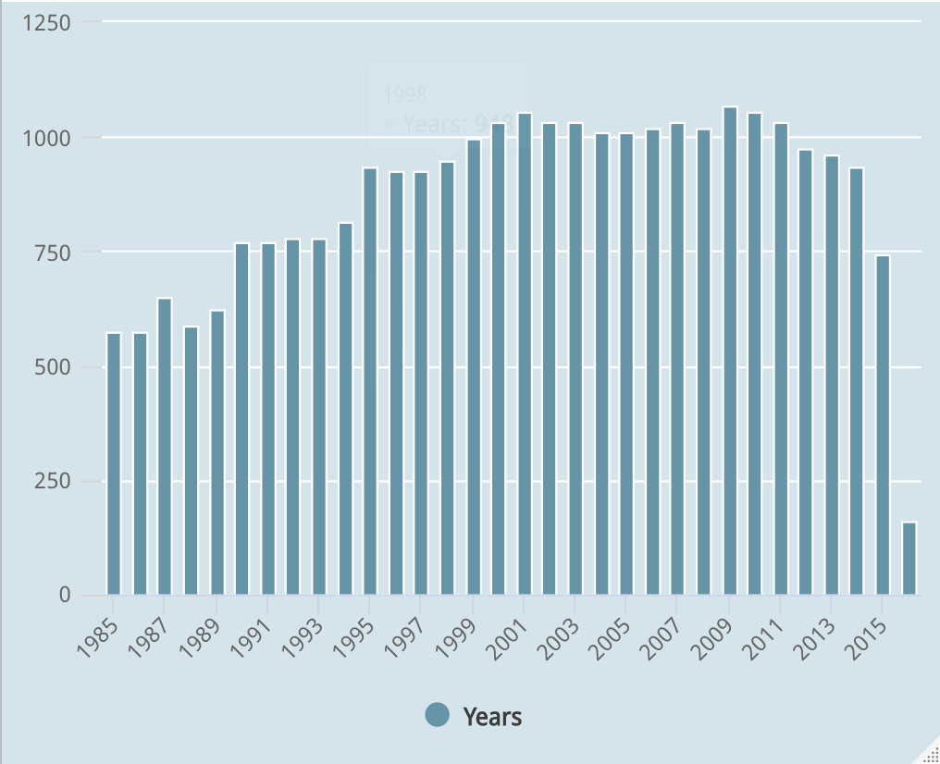
Year We can see the suicide rate was very less in the early 80's and gained it's peak in early 20's which continue to fluctuate overtime, but the suicide rate has decreased drastically as we can see in 2015 & 2016.

Slide 7
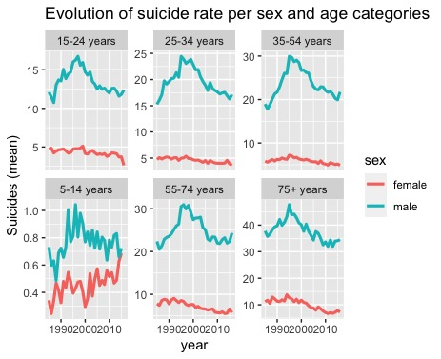
Suicide rates by Sex and Age group We can see from the graph that for all the times for all age groups suicide rate is higher for men than women. This means 'sex' variable differentiates the population of dataset. ((It helps us to answer which age-group, gender is mostly the victimis of suicide. ))
Notes:
Ridership is based on weather as well.
When weather clear, number of ridership is high.

Slide 8
Techniques Used :
Analysis Of Variance
Principle Component Analysis
Multiple Linear Regression
Factor Analysis
Clustering

Slide 9
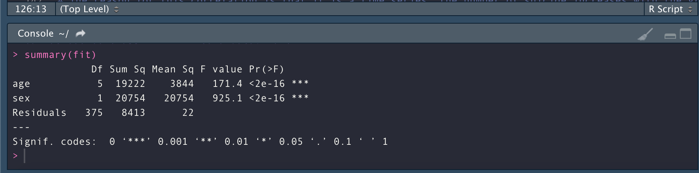
Analysis Of Variance:
temp <- data %>% group_by(year,sex, age) %>%
summarize(moy_suicide = mean(suicides.100k.pop))
fit <- aov(formula = moy_suicide~age+sex, data = temp)
summary(fit)
There's a Statistical significance difference between the two groups (men and women).
This difference is stronger than the age group.
(Look at the F value, by default R doesn’t print numbers < to 2e-16).

Slide 10
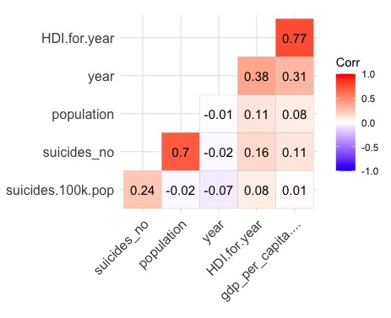
Correlation between the Quantitative Variables
options(repr.plot.height = 4, repr.plot.res = 180, repr.plot.width = 6)
data[,sapply(data, is.numeric)] %>%
cor(use = "complete.obs") %>% ggcorrplot(hc.order = TRUE, type = "lower", lab = TRUE)
Human development index correlates positively with the per capita GDP (0.77),
which means that these two variables tend to go in the same direction.
The number of suicide is positively correlated with the population (country).
The reason for this correlation is that it is a time series: the number of suicide increases with the growth of the population which itself increases with time, the same goes for the GDP, which increases every year.

Slide 11
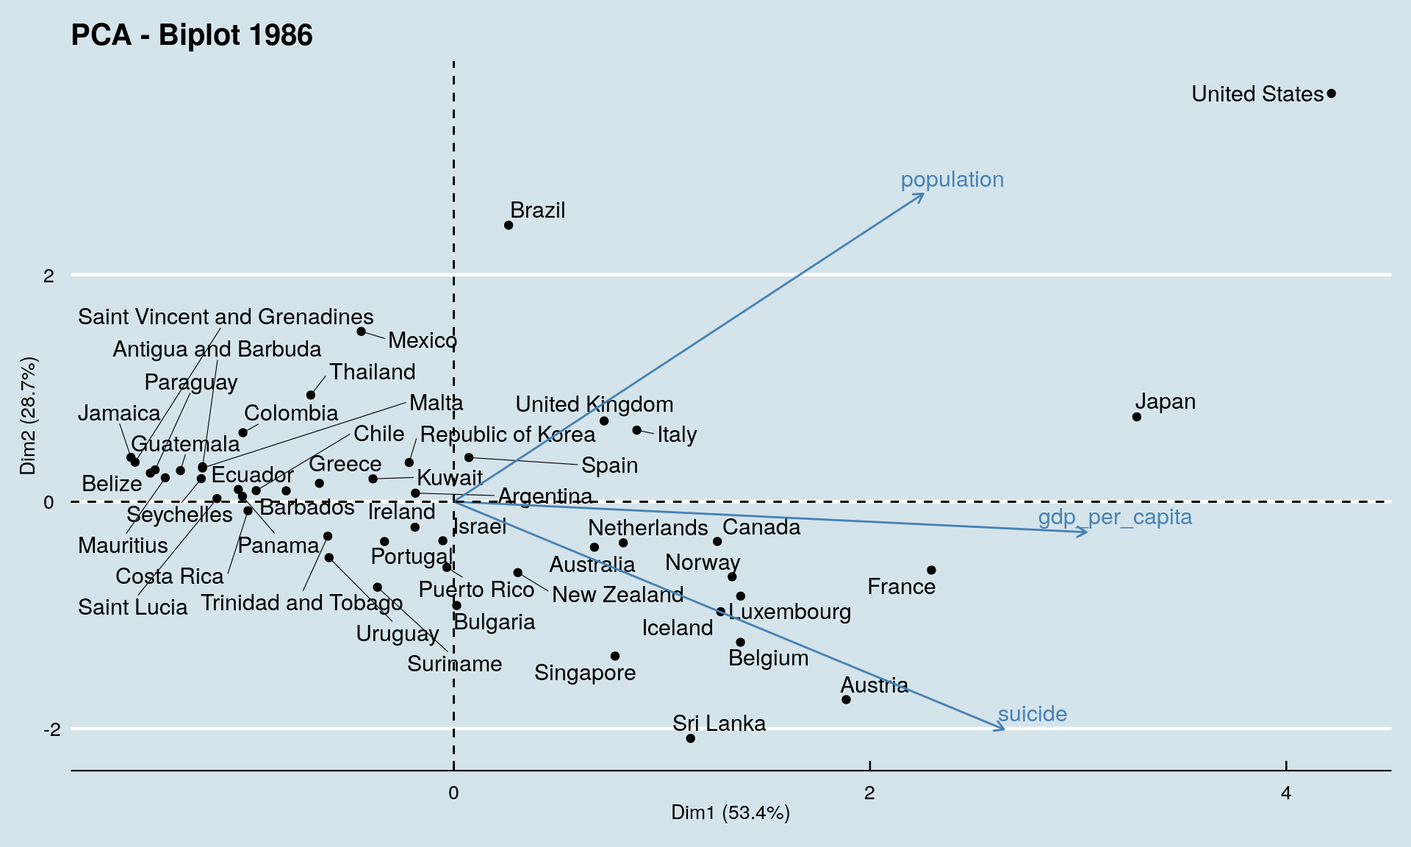
Principle Component Analysis
The first dimension explains 53% of the variability among the countries. It is positively influenced by the 3 variables, but GDP per capita has a stronger influence on this first dimension.
The second dimension explains 29% of information and is strongly influenced positively by the population and negatively by suicide.
These two axes allow us to say that a country whose coordinates are located to the right of this graph is a rich country. Similarly a country located at the top is a populated country.
If the country is located at the bottom of the graph the higher is the proportion of suicide in that country.
Notes:
Spliting data into training and testing sets. Took 90% of data for the training set and rest of 10% for the testing.

Slide 12
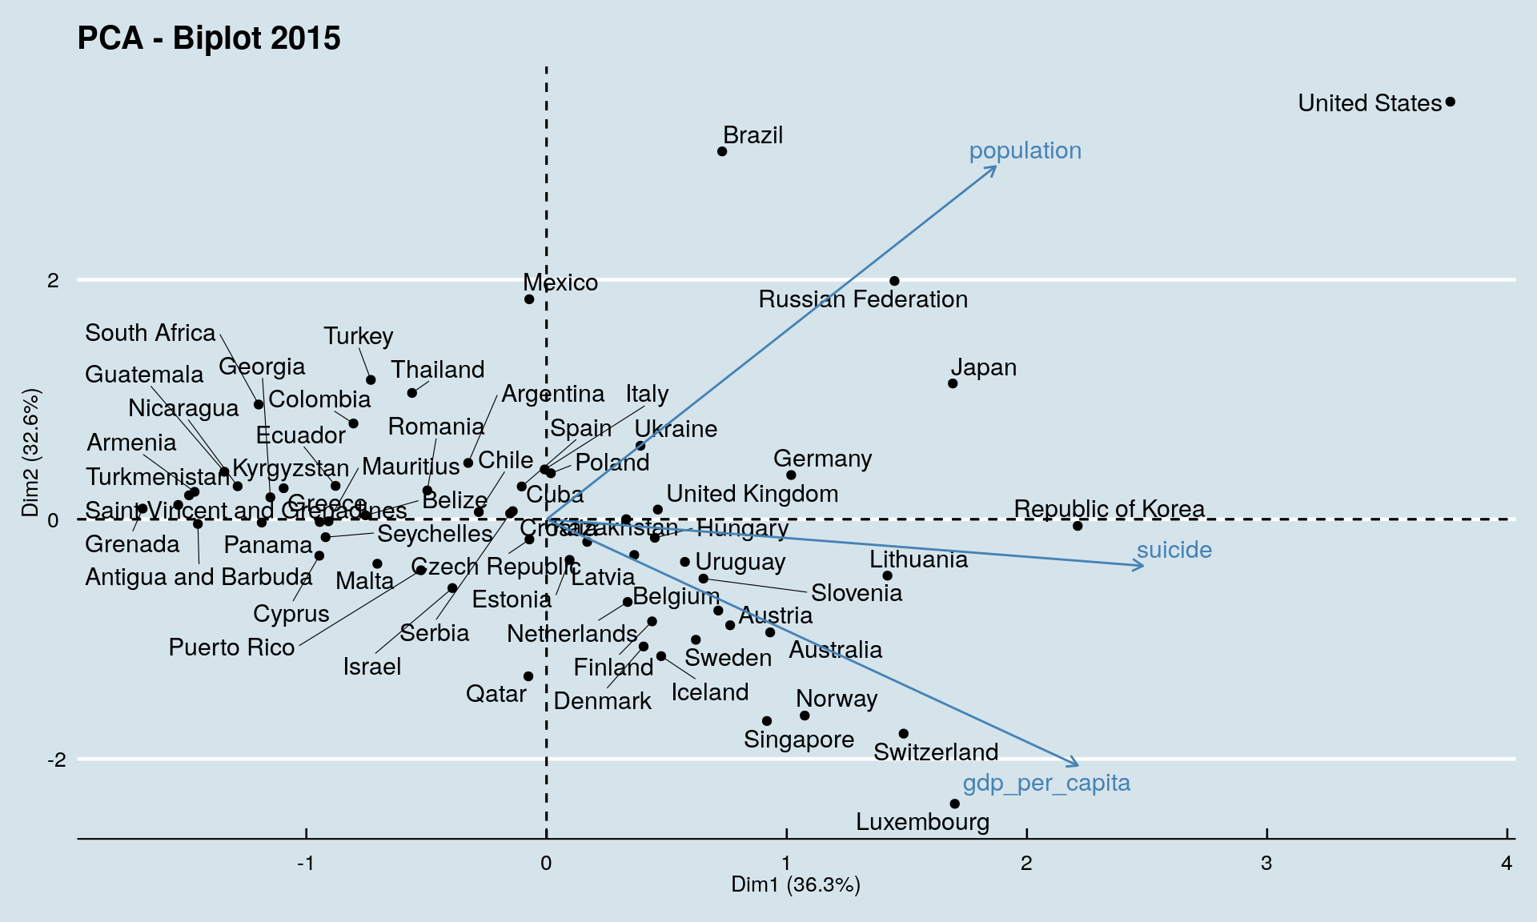
In 2015
Compared to the results obtained in 1986, the two dimensions have about the same importance.
Suicide is not as important as it was in 1986. The direcion of arrows has changed: the more a country is on the right, the higher its suicide rate.
The countries on the top right are countries with a large population and a high suicide rate.
While the countries at the bottom have a small population but a very high GDP per capita.
Notes:
Demand is influenced by factors such as the Season, Month and Weather Conditions
The plot shows the prediction of the bike users according to the factors like temperature, season, workingday, humidity and month to predict the count of the number of the bike users.
The factors like temperature and season/weather affect the number of users badly and it decreases with a bad weather or high or very low temperature. The same happens with holidays/weekdays/weekends also.

Slide 13
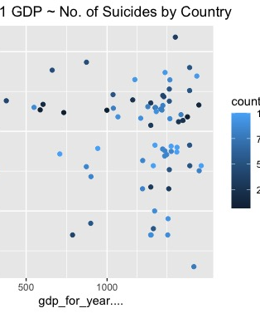
Clustering
Cluster 1
Victims in Cluster 1 are from Japan, Ukraine, and the United States.
Ukraine victims have the lowest GDP for Year and Suicide Numbers of the three.
They are all Male.
Their ages range from 15-74, with the age group 35-54 having the greatest value in Number of Suicides.

Slide 14
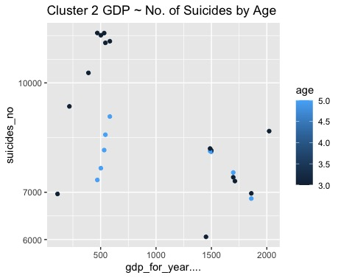
Cluster 2
Victims in Cluster 2 are all from the United States.
They are all Male.
Their ages range from 35-74, with the age group 35-54 having the greatest number of observations.

Slide 15
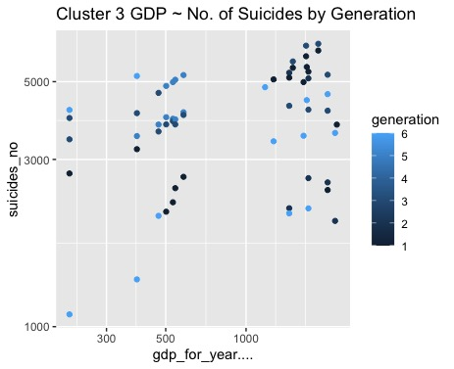
Cluster 3
Victims in Cluster 3 are all from the United States.
They are composed of Males and Females, however, the majority of victims in this cluster are Female.
Their ages range from 15-75+, with the age group 24-34 having the greatest number of suicides between 2010 and 2014.
Millennials have the greatest number of suicides between the year 2011 and 2014.
Number of Suicides for each age group have not changed much since year 2000.

Slide 16
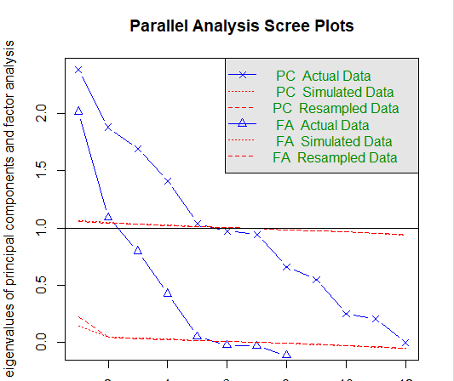
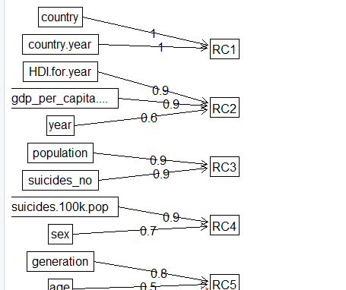
Factor Analysis
Scree Plot is a line plot that helps to determine no of factors or the principal component in an analysis.
After applying factor analysis we have considered 3 factors were having minimum loss of unique variance.

Slide 17
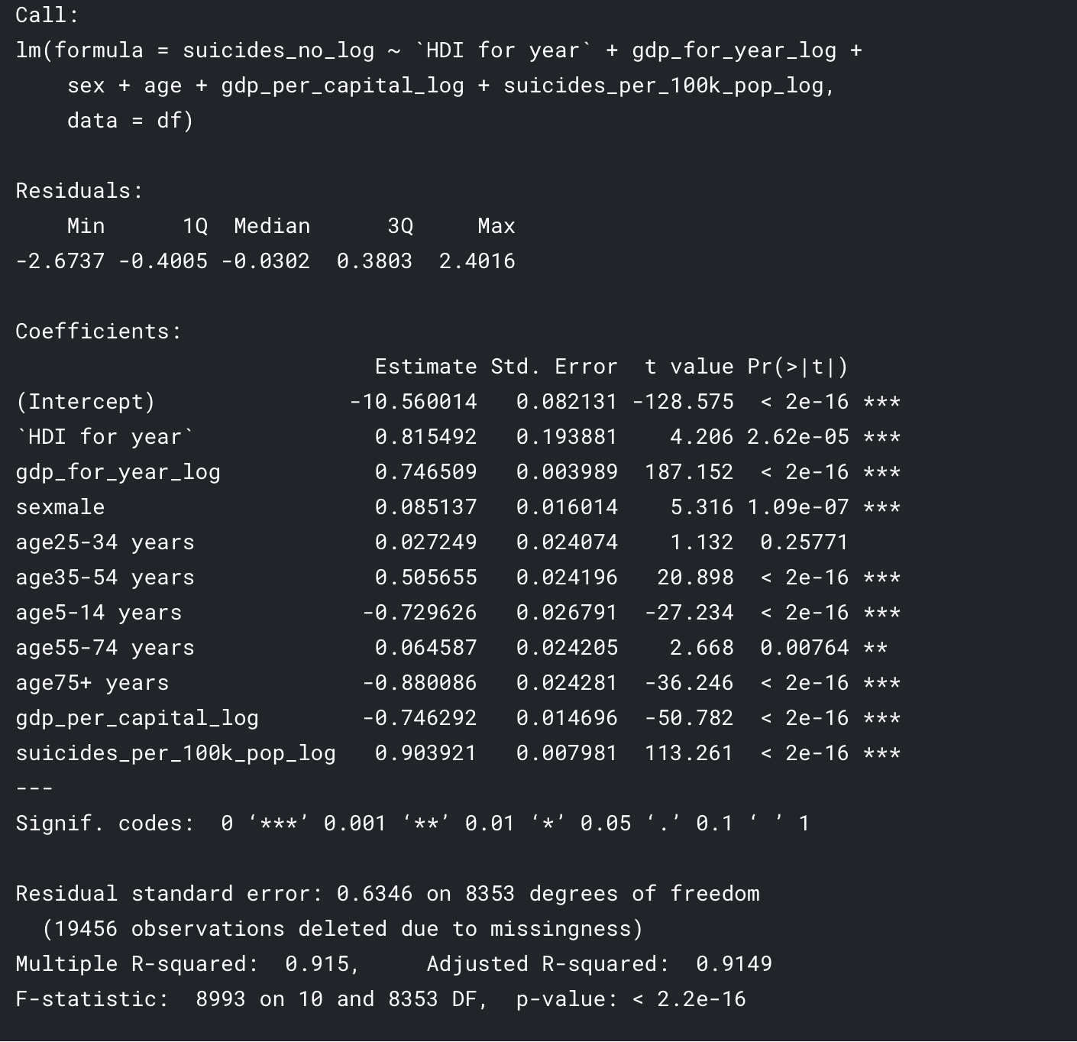
Multiple Linear Regression
mod7 <- lm(data = df , suicides_no_log ~ `HDI for year` + gdp_for_year_log + sex + age + gdp_per_capital_log + suicides_per_100k_pop_log) summary(mod7)
We can say that those set of variables can be represent the cause of suicide rate 91.49% variation. For another percentage maybe due to another factor that we don't have here.
To evaluate the model whether it's doing a great job or not. One of the assumption we can check is the residual distribution. We expected to be normally distributed.
Notes:
Test shows thst its not stationery as test stat is higher than 1.
Seasonality is removed and differencinfg is applied to make the data stationery.
First step to ARIMA modelling is making it stationery.
Kpss test to see wether data is stationery or not.
After we do the test, we obtain that the test statistic is much bigger than the 1% critical value, indicating that the null hypothesis is rejected.
That is, the data are not stationary. We can difference the data and apply the test again.
In other words, a stationary time series is one whose properties do not depend on the time at which the series is observed.
❑ So time series with trends, or with seasonality, are not stationary — the trend and seasonality will affect the value of the time series at different times. On the other hand, a white noise series is stationary — it does not matter when you observe it, it should look much the same at any period of time.
Transformations such as logarithms can help to stabilize the variance of a time series.
❑Differencing can help stabilize the mean of a time series by removing changes in the level of a time series, and therefore eliminating (or reducing) trend and seasonality.

Slide 18
THANK YOU

